Slide 1
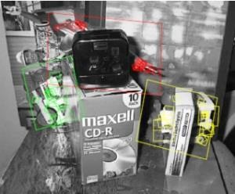
Instance Recognition
Jia-Bin Huang Virginia Tech
ECE 6554 Advanced Computer Vision

Slide 2
Administrative stuffs
Paper review submitted?
Topic presentation
Experiment presentation
“For”/ “Against” discussion lead
Questions?

Slide 3
Today’s class
Review keypoint detection and descriptors
Review SIFT features
Indexing features
Fast image search

Slide 4
Discussion – Think-pair-share
Find a person you don’t know
Discuss
strength,
weakness, and
potential extension
Share with class

Slide 5
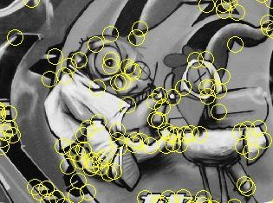
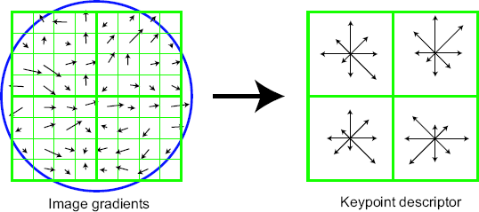
Keypoint detection and descriptors
Keypoint detection: repeatable and distinctive
Corners, blobs, stable regions
Harris, DoG
Descriptors: robust and selective
spatial histograms of orientation
SIFT

Slide 6
Local Descriptors
The ideal descriptor should be
Robust
Distinctive
Compact
Efficient
Most available descriptors focus on edge/gradient information
Capture texture information
Color rarely used
K. Grauman, B. Leibe

Slide 7
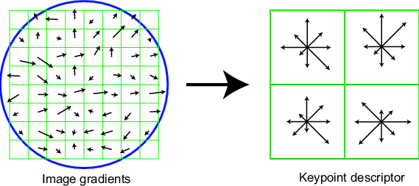


Scale Invariant Feature Transform
Basic idea:
Take 16x16 square window around detected feature
Compute edge orientation (angle of the gradient - 90°) for each pixel
Throw out weak edges (threshold gradient magnitude)
Create histogram of surviving edge orientations
0
2π
angle histogram
Adapted from slide by David Lowe

Slide 8
SIFT descriptor
Full version
Divide the 16x16 window into a 4x4 grid of cells (2x2 case shown below)
Compute an orientation histogram for each cell
16 cells * 8 orientations = 128 dimensional descriptor
Adapted from slide by David Lowe

Slide 9
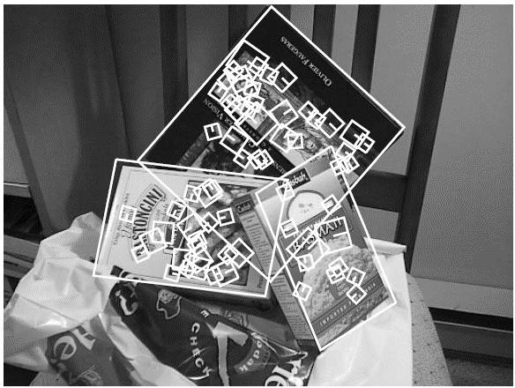
Local Descriptors: SIFT Descriptor
Histogram of oriented gradients
Captures important texture information
Robust to small translations / affine deformations
[Lowe, ICCV 1999]
K. Grauman, B. Leibe

Slide 10
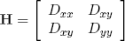
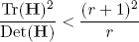
Details of Lowe’s SIFT algorithm
Run DoG detector
Find maxima in location/scale space
Remove edge points
Find all major orientations
Bin orientations into 36 bin histogram
Weight by gradient magnitude
Weight by distance to center (Gaussian-weighted mean)
Return orientations within 0.8 of peak
Use parabola for better orientation fit
For each (x,y,scale,orientation), create descriptor:
Sample 16x16 gradient mag. and rel. orientation
Bin 4x4 samples into 4x4 histograms
Threshold values to max of 0.2, divide by L2 norm
Final descriptor: 4x4x8 normalized histograms
Lowe IJCV 2004

Slide 11





SIFT Example
sift
868 SIFT features

Slide 12
Feature matching
Given a feature in I₁, how to find the best match in I₂?
Define distance function that compares two descriptors
Test all the features in I₂, find the one with min distance

Slide 13
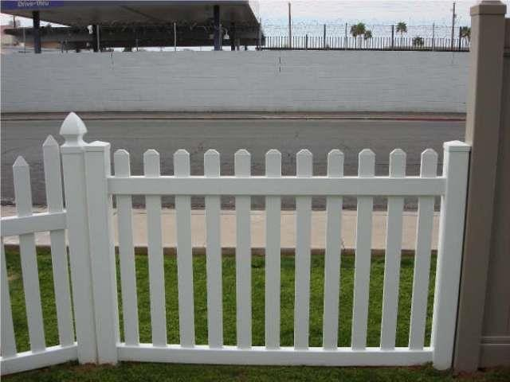
Feature distance
How to define the difference between two features f₁, f₂?
Simple approach: L₂ distance, ||f₁ - f₂ ||
can give good scores to ambiguous (incorrect) matches
f₁
f₂
I₁
I₂

Slide 14
Feature distance
How to define the difference between two features f₁, f₂?
Better approach: ratio distance = ||f₁ - f₂ || / || f₁ - f₂’ ||
f₂ is best SSD match to f₁ in I₂
f₂’ is 2nd best SSD match to f₁ in I₂
gives large values for ambiguous matches
f₁ f₂ f₂
'
I₁
I₂

Slide 15


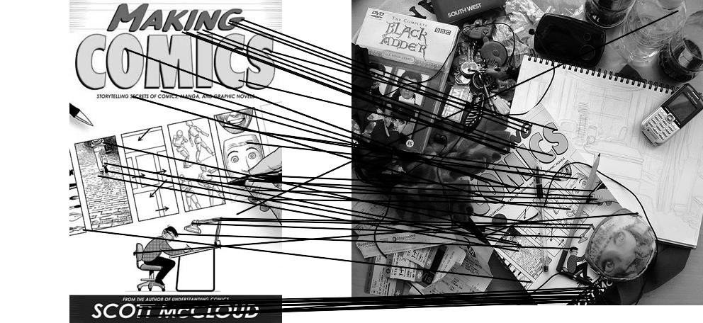

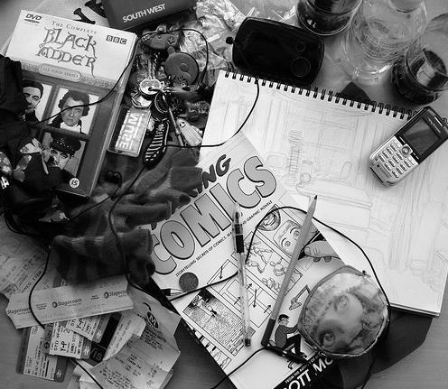
Feature matching example
51 matches

Slide 16
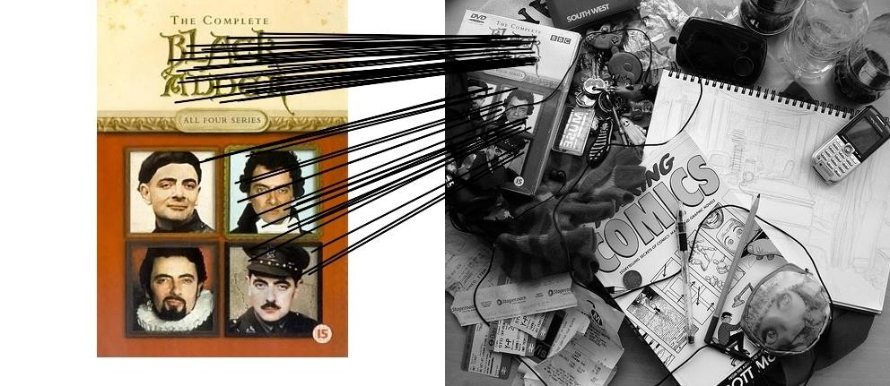

Feature matching example
58 matches

Slide 17
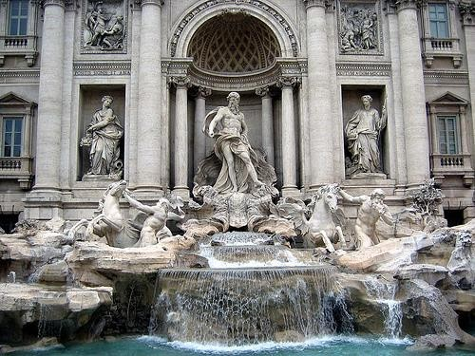
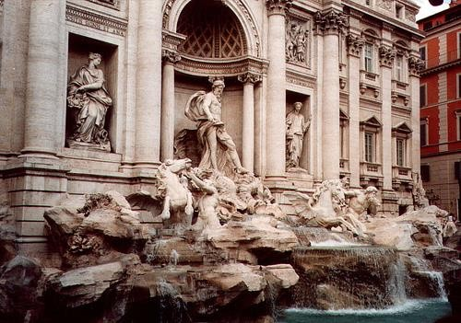
Evaluating the results
How can we measure the performance of a feature matcher?
50
75
200
feature distance

Slide 18
True/false positives
How can we measure the performance of a feature matcher?
50
75
200
true match
false match
feature distance
The distance threshold affects performance
True positives = # of detected matches that are correct
Suppose we want to maximize these—how to choose threshold?
False positives = # of detected matches that are incorrect
Suppose we want to minimize these—how to choose threshold?

Slide 19
Evaluating the results
How can we measure the performance of a feature matcher?
1
0.7
# true positives
# correctly matched features (positives)
“recall”
true positive rate
0
0.1
false positive rate
1
# false positives # incorrectly matched features (negatives)
1 - “precision”

Slide 20
Evaluating the results
How can we measure the performance of a feature matcher?
ROC curve (“Receiver Operator Characteristic”)
1
0.7
# true positives
# correctly matched features (positives)
“recall”
true positive rate
0
0.1
false positive rate
1
# false positives # incorrectly matched features (negatives)
1 - “precision”

Slide 21
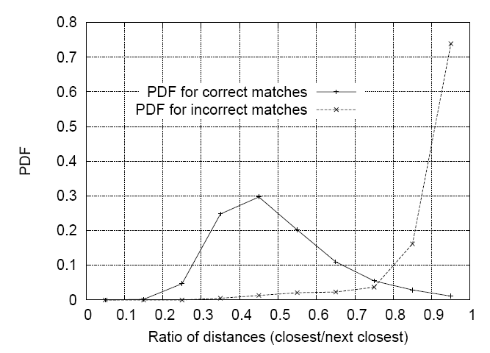
Matching SIFT Descriptors
Nearest neighbor (Euclidean distance)
Threshold ratio of nearest to 2nd nearest descriptor
Lowe IJCV 2004

Slide 22
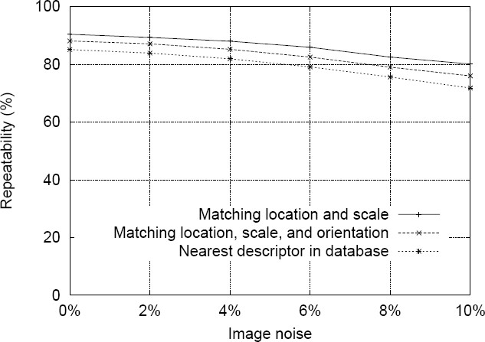
SIFT Repeatability
Lowe IJCV 2004

Slide 23
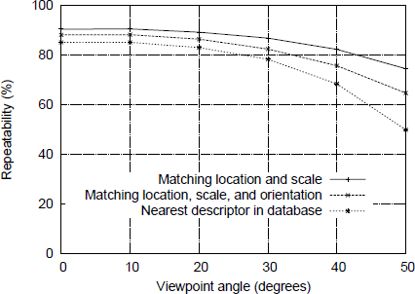
SIFT Repeatability

Slide 24
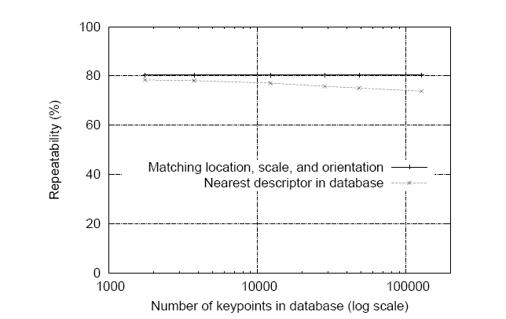
SIFT Repeatability
Lowe IJCV 2004

Slide 25
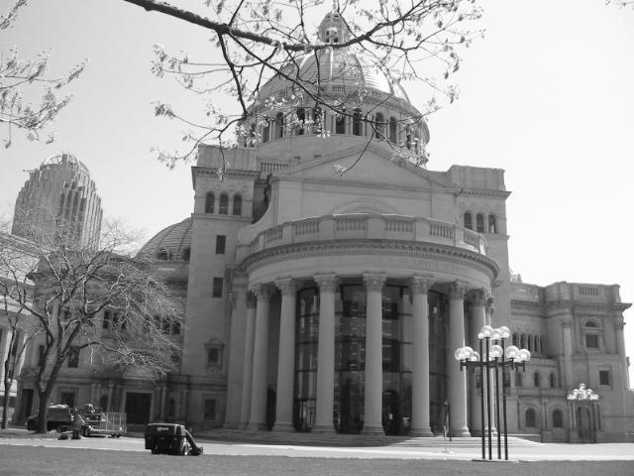
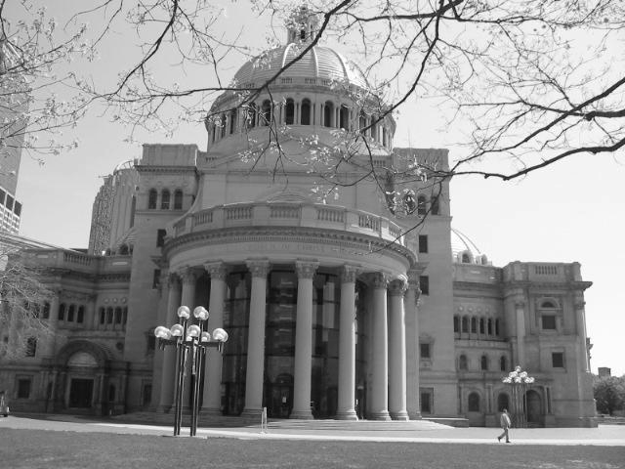
Matching local features
Kristen Grauman

Slide 26
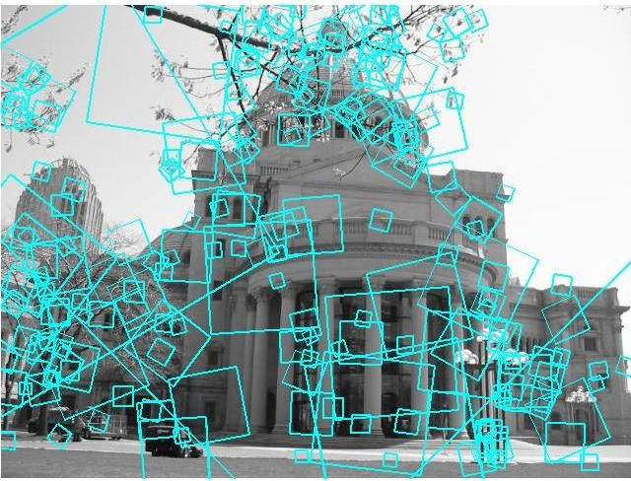
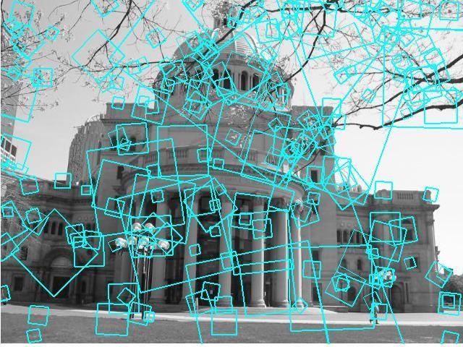
Matching local features
?
Image 1 Image 2
To generate candidate matches, find patches that have the most similar appearance (e.g., lowest SSD)
Simplest approach: compare them all, take the closest (or closest k, or within a thresholded distance)
Kristen Grauman

Slide 27
Matching local features
Image 1 Image 2
In stereo case, may constrain by proximity if we make assumptions on max disparities.
Kristen Grauman

Slide 28
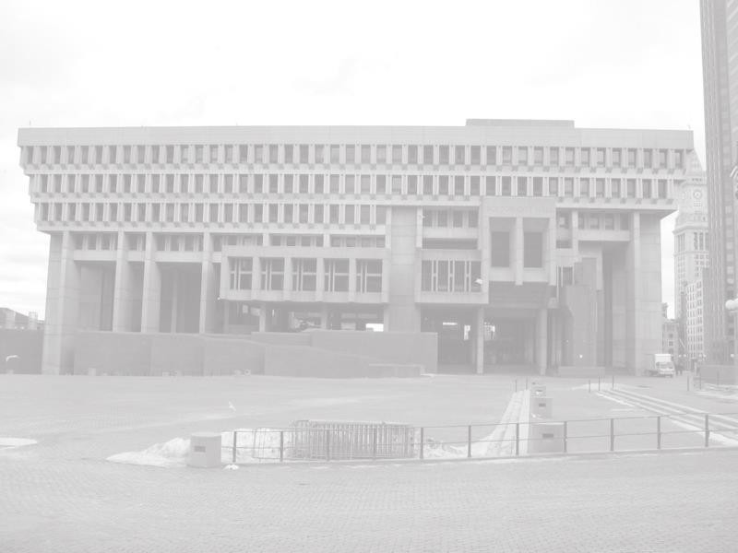




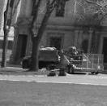
Indexing local features
…
Kristen Grauman

Slide 29
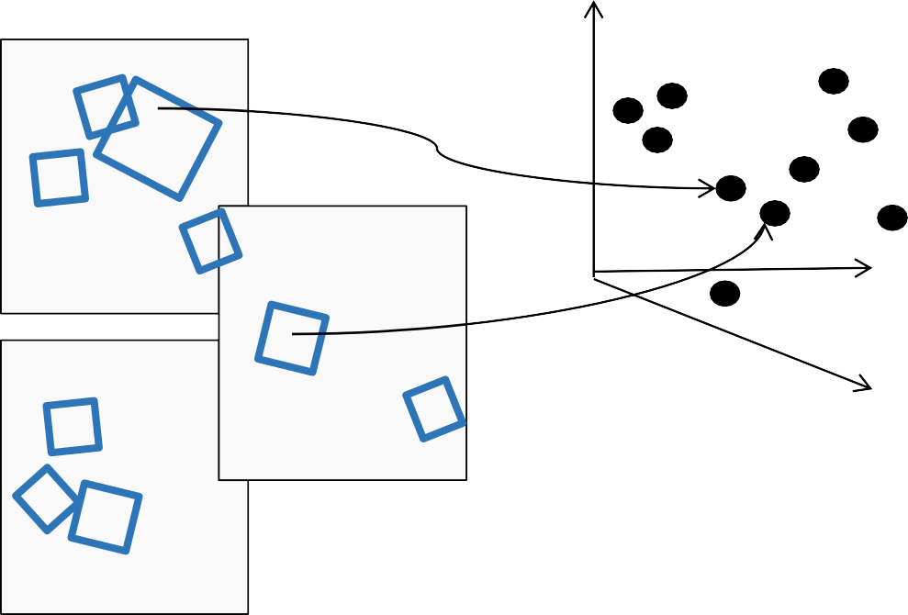
Indexing local features
Each patch / region has a descriptor, which is a point in some high-dimensional feature space (e.g., SIFT)
Descriptor’s feature space
Kristen Grauman

Slide 30
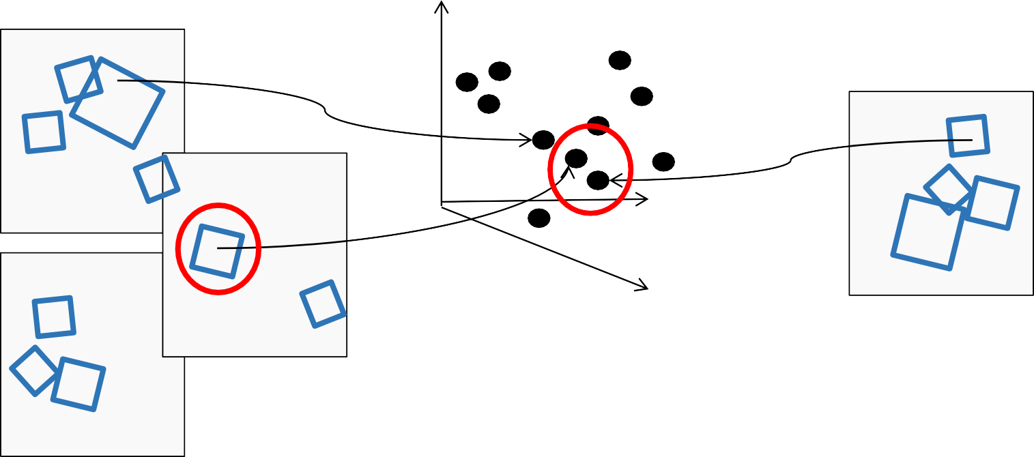
Indexing local features
When we see close points in feature space, we have similar descriptors, which indicates similar local content.
Query image
Descriptor’s feature space
Database images
Kristen Grauman

Slide 31
Indexing local features
With potentially thousands of features per image, and hundreds to millions of images to search, how to efficiently find those that are relevant to a new image?
Kristen Grauman

Slide 32
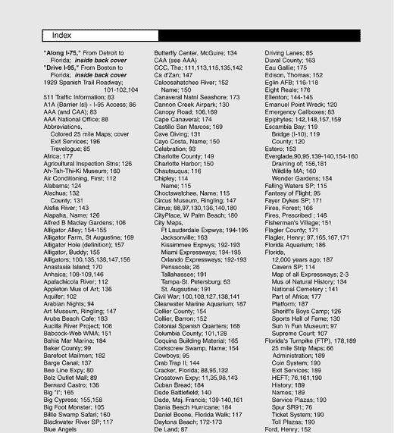
Indexing local features: inverted file index
For text documents, an efficient way to find all pages on which a word occurs is to use an index…
We want to find all images in which a feature occurs.
To use this idea, we’ll need to map our features to “visual words”.
Kristen Grauman

Slide 33
Text retrieval vs. image search
What makes the problems similar, different?
Kristen Grauman

Slide 34

Visual words: main idea
Extract some local features from a number of images …
e.g., SIFT descriptor space: each point is 128-dimensional
34
Slide credit: D. Nister, CVPR 2006

Slide 35
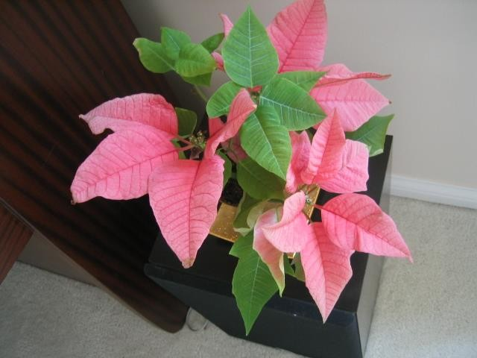
Visual words: main idea

Slide 36
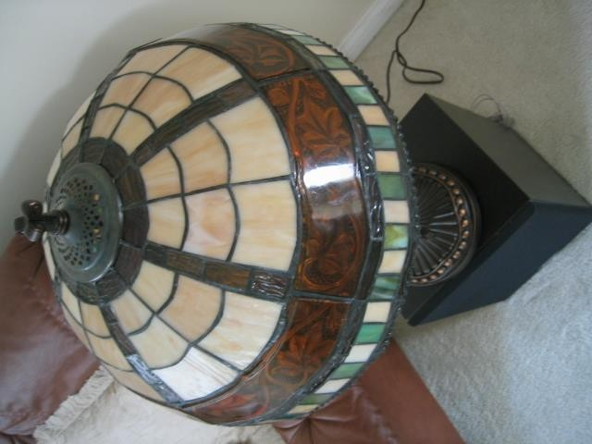

Visual words: main idea

Slide 37

Visual words: main idea

Slide 38
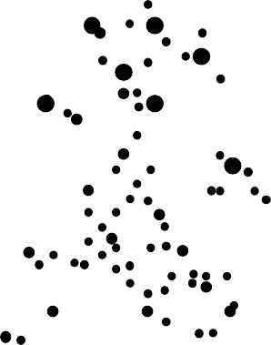
Each point is a local descriptor,
e.g. SIFT vector.

Slide 40
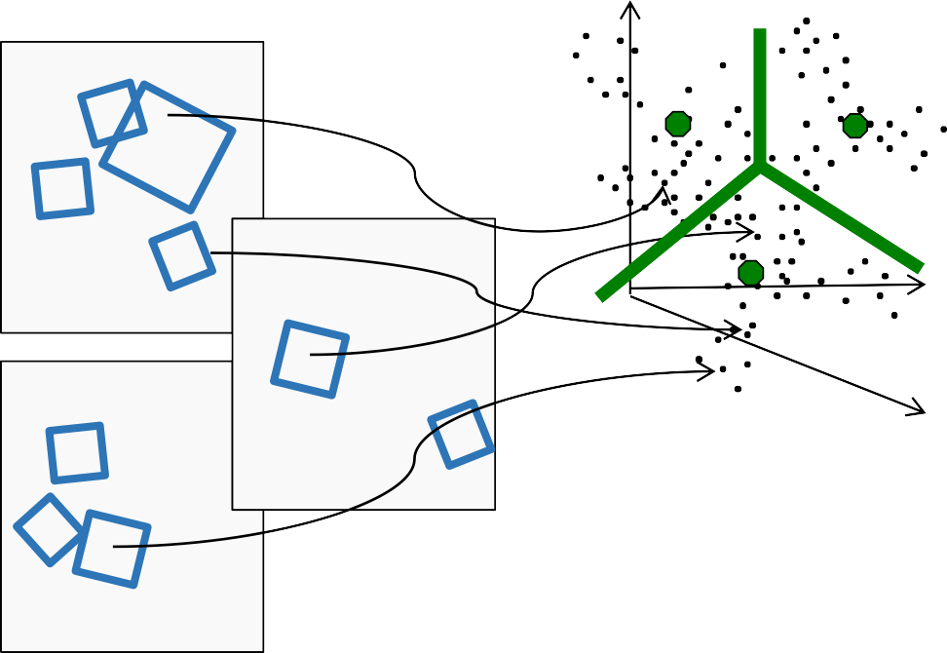
Visual words
Map high-dimensional descriptors to tokens/words by quantizing the feature space
Quantize via clustering, let cluster centers be the
prototype “words”
Word #2
Determine which word to assign to each new image region by finding the closest cluster
Descriptor’s feature space
center.
40
Kristen Grauman

Slide 41
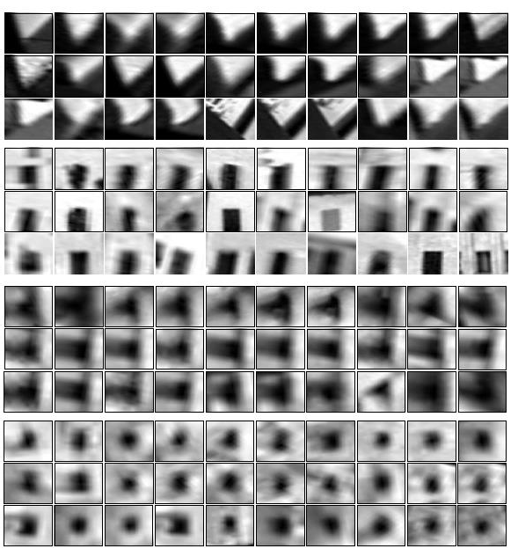
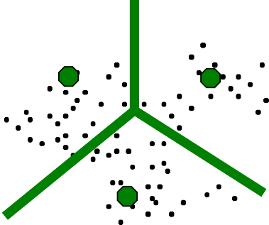
Visual words
Example: each group of patches belongs to the same visual word
Figure from Sivic & Zisserman, ICCV 2003
41
Kristen Grauman

Slide 42
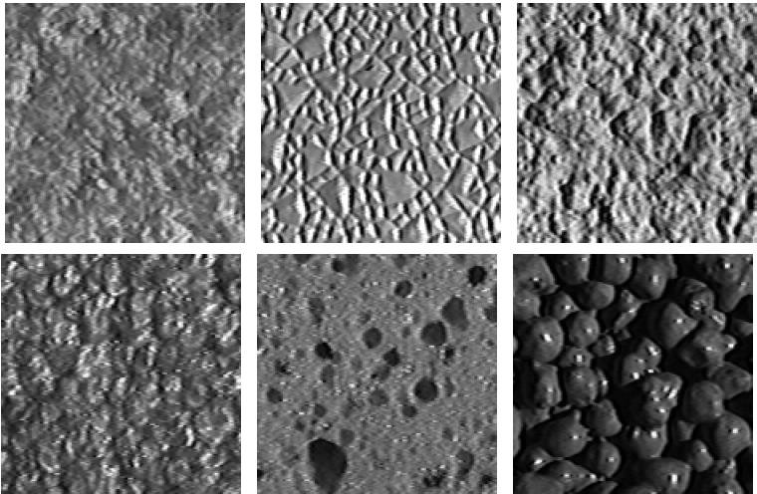
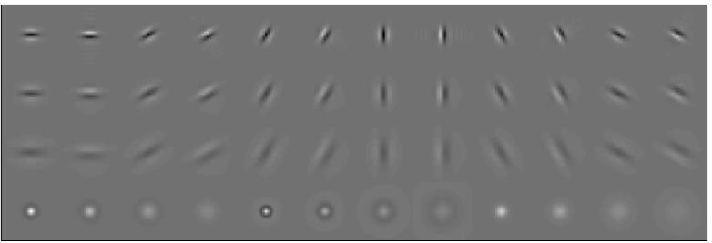
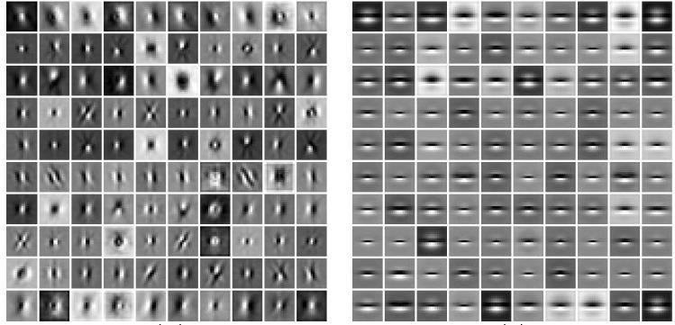
Visual words and textons
First explored for texture and material representations
Texton = cluster center of filter responses over collection of images
Describe textures and materials based on distribution of prototypical texture elements.
Leung & Malik 1999; Varma & Zisserman, 2002
Kristen Grauman

Slide 43
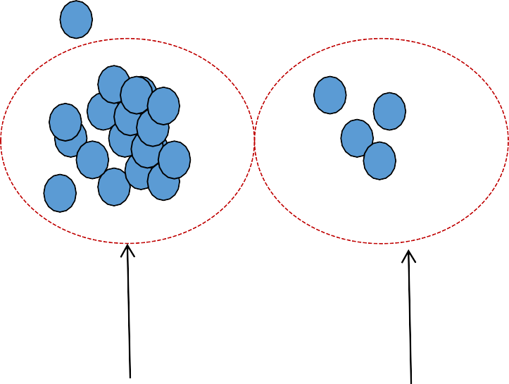
Recall: Texture representation example
Windows with
primarily horizontal edges
Both
Dimension 2 (mean d/dy value)
 | mean d/dx value | mean d/dy value
Win. #1 | 4 | 10
Win.#2 | 18 | 7
Win.#9 | 20 | 20
…
Dimension 1 (mean d/dx value)
…
statistics to summarize patterns in small windows
Windows with small gradient in both directions
Windows with primarily vertical edges
Kristen Grauman

Slide 44
Visual vocabulary formation
Issues:
Sampling strategy: where to extract features?
Clustering / quantization algorithm
Unsupervised vs. supervised
What corpus provides features (universal vocabulary?)
Vocabulary size, number of words
Kristen Grauman

Slide 45
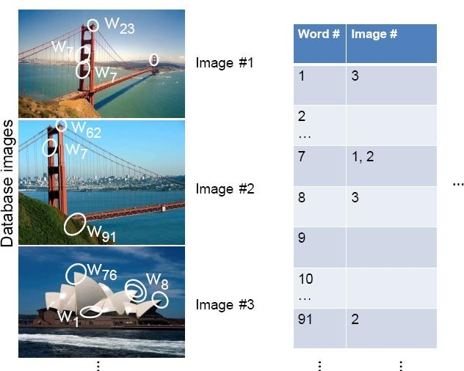
Inverted file index
Database images are loaded into the index mapping words to image numbers
Kristen Grauman

Slide 46
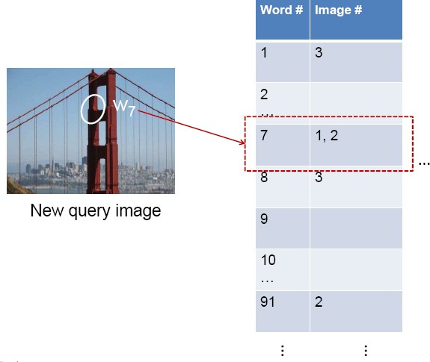
Inverted file index
New query image is mapped to indices of database
images that share a word.
47
Kristen Grauman

Slide 47
If a local image region is a visual word, how can we summarize an image (the document)?
48

Slide 48


Analogy to documents
Of all the sensory impressions proceeding to the brain, the visual experiences are the dominant ones. Our perception of the world around us is based essentially on the messages that reach the
brain from our eyes. For a long time it was thought that the sreetinnasloimryag,ebwraasitnra,nsmitted
China is forecasting a trade surplus of $90bn (£51bn) to $100bn this year, a threefold increase on 2004's $32bn. The Commerce Ministry said the surplus would be created by a predicted 30%
jump in exports to $750bn, compared with a 18% rise in imports to $C6h60inbna. ,Thterafidguere,s are likely to
point by point_{v}to_{is}v_{u}isu_{a}a_{l}l,c_{p}en_{e}te_{r}r_{c}s_{e}in_{p}t_{t}h_{i}e_{o}b_{n}ra,in; the
further annoy_{su}th_{r}e_{p}U_{l}S_{u}, w_{s,}hi_{c}c_{o}h _{m}has_{m}lo_{e}ng_{rc}ar_{e}g,ued that
cerebral cortex was a movie screen, so to speak,
China's exports are unfairly helped by a
upon whichrethteinimaalg,ecinetrheebeyreawl casoprrtoejexct,ed. Through the disc_{e}o_{y}ve_{e}r,ie_{c}s _{e}of_{ll}H,u_{o}be_{p}l _{t}a_{i}n_{c}d_{a}W_{l} iesel we
deliberatelyeuxndpeorvratluse,dimyuapno. rBtesij,inUg aSg,rees the surplus_{y}is_{u}to_{a}o_{n}h,ig_{b}h_{a}, b_{n}u_{k}t s,a_{d}ys_{o}th_{m}e _{e}yu_{s}a_{t}n_{ic}is,only
one factor. Bank of China governor Zhou
now know that behind the origin of the visual
perception in the b^{n}ra^{e}in^{rv}th^{e}er,e^{im}is aªc^{g}on^{e}siderably
more complicatedHcouubrsee lo,f Weveinetss.eBly following
the visual impulses along their path to the
various cell layers of the optical cortex, Hubel and Wiesel have been able to demonstrate that the message about the image falling on the retina undergoes a step-wise analysis in a system of nerve cells stored in columns. In this system each cell has its specific function and is responsible for a specific detail in the pattern of the retinal image.
Xiaochuan said^{f}tºh^{r}e^{e}co^{ig}un^{n}t,ry^{in}al^{c}so^{re}neªe^{s}d^{e}ed, to do
more to boost domtersaticddee,mvaandlusoemore goods
stayed within the country. China increased the
value of the yuan against the dollar by 2.1% in July and permitted it to trade within a narrow band, but the US wants the yuan to be allowed to trade freely. However, Beijing has made it clear that it will take its time and tread carefully before allowing the yuan to rise further in value.
ICCV 2005 short course, L. Fei-Fei

Slide 49
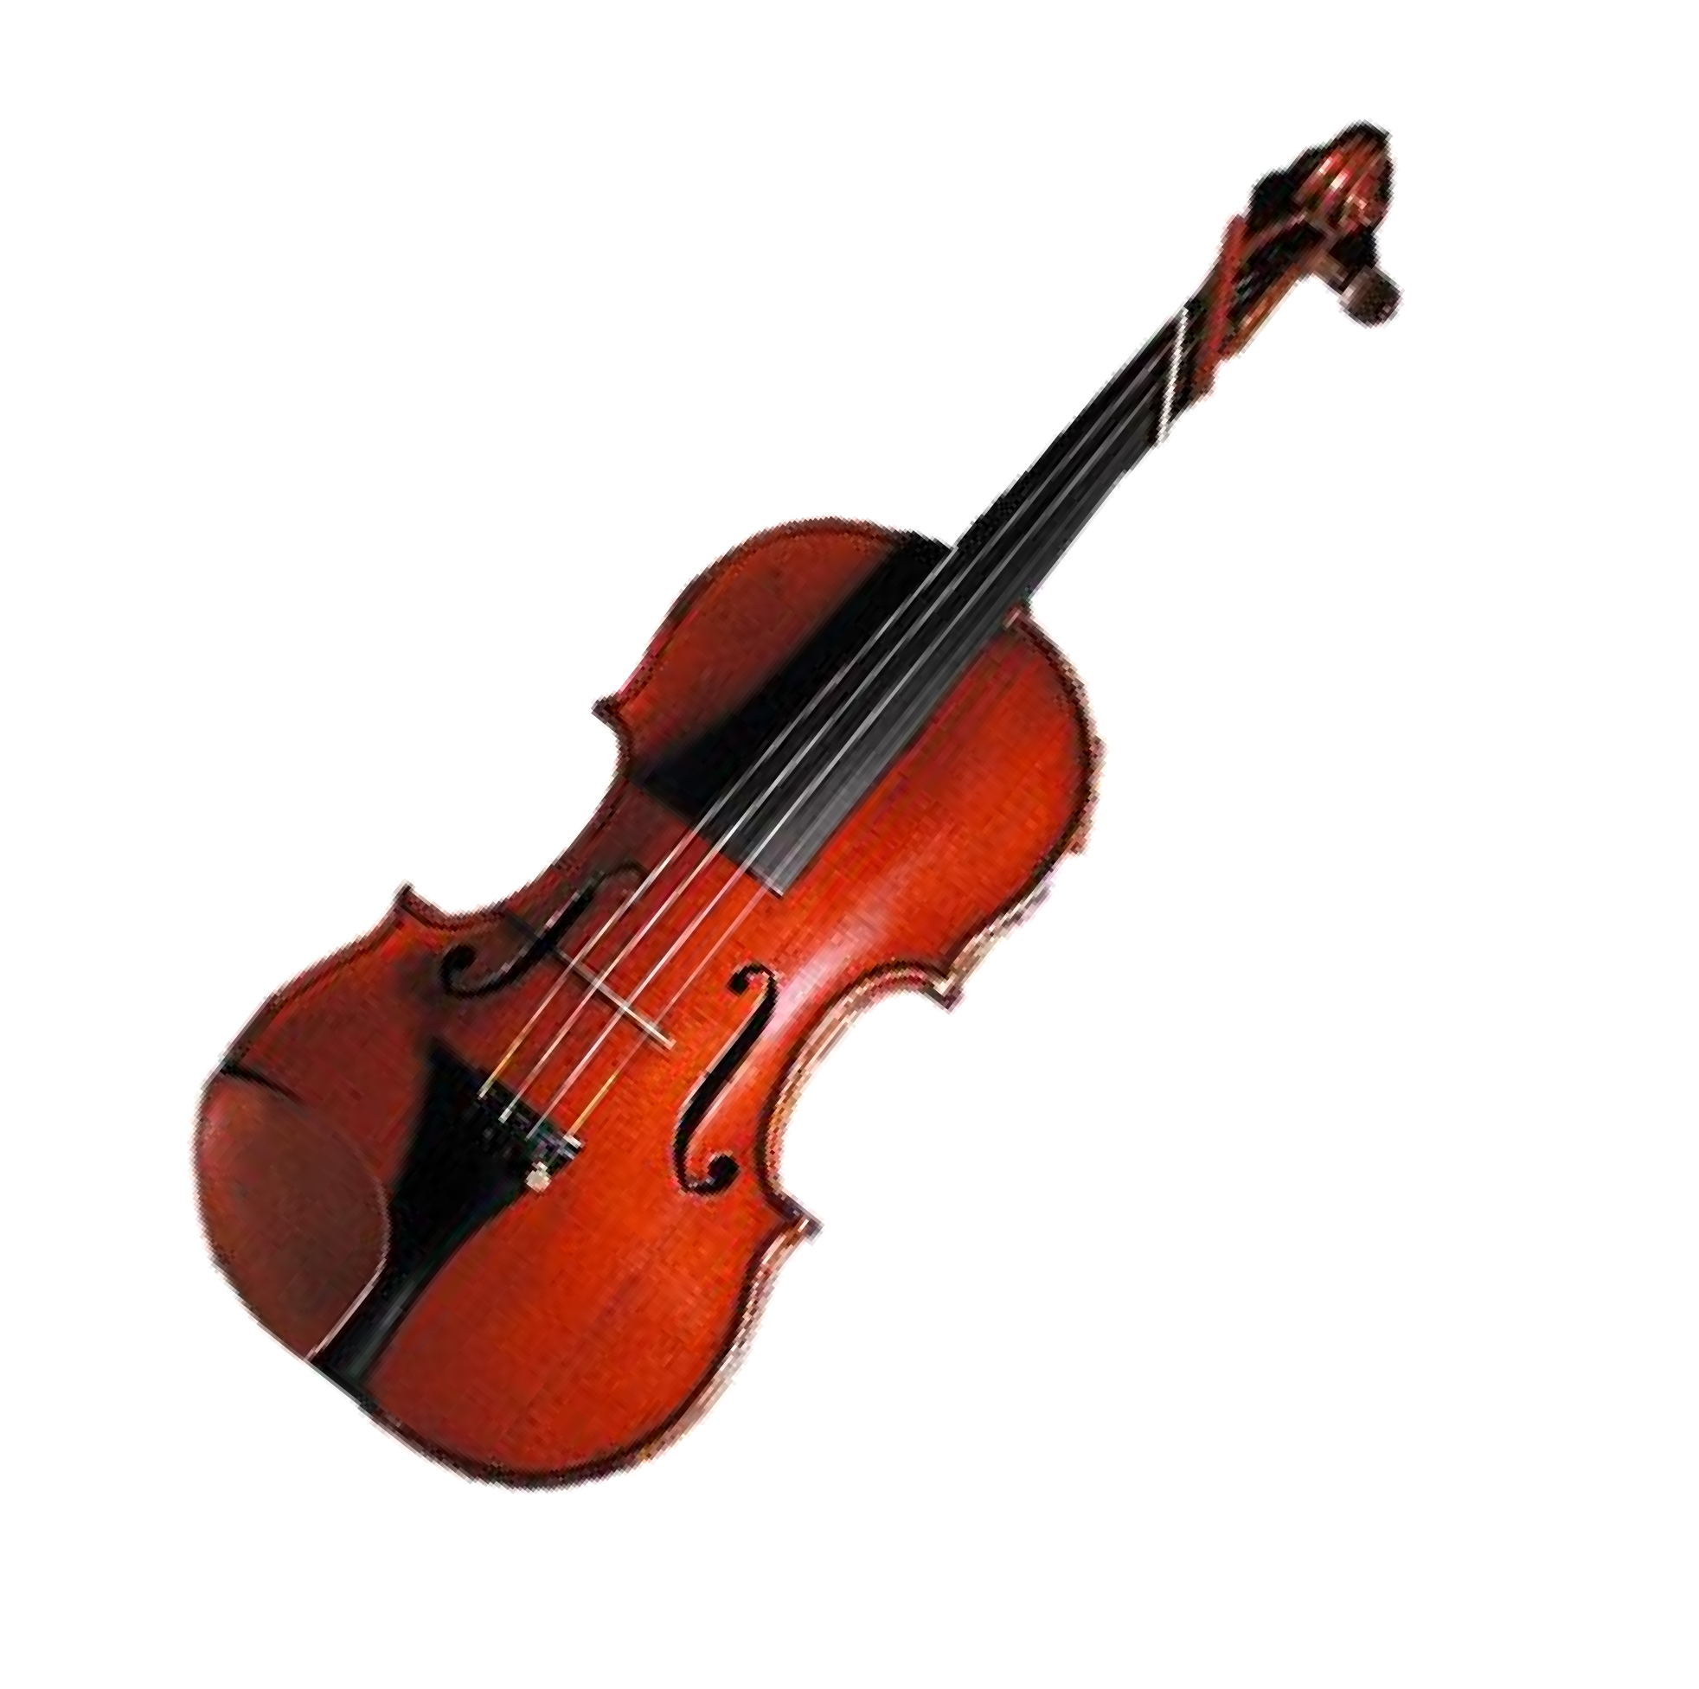
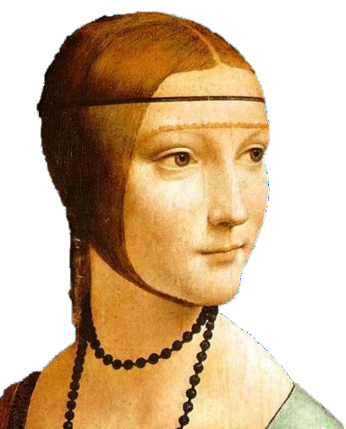
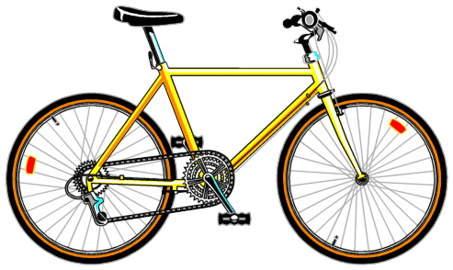


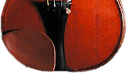

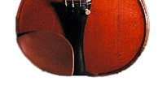


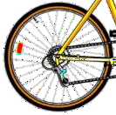


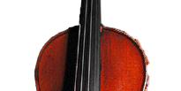
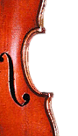
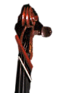
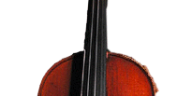
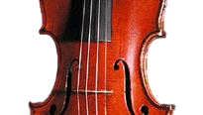





Slide 50



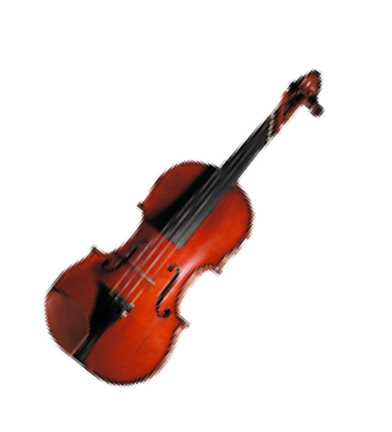






Bags of visual words
Summarize entire image based on its distribution (histogram) of word occurrences.
Analogous to bag of words representation commonly used for documents.

Slide 51








Comparing bags of words
Rank frames by normalized scalar product between their (possibly weighted) occurrence counts---nearest neighbor search for similar images.
[1 8 1 4] [5 1 1 0]
_{q}
❒
d _{j}
52
Kristen Grauman

Slide 52

Bags of words for content-based image retrieval
Slide from Andrew Zisserman
53
Sivic & Zisserman, ICCV 2003

Slide 53

Slide from Andrew Zisserman
Sivic & Zisserman, ICCV 2003
54

Slide 54











Scoring retrieval quality
Results (ordered):
Database size: 10 images
Relevant (total): 5 images
Query
precision = #relevant / #returned
recall = #relevant / #total relevant
1
0.8
0.6
0.4
0.2
precision
0
0
0.2
0.4
0.6
0.8
1
recall
55
Slide credit: Ondrej Chum

Slide 55








Vocabulary Trees: hierarchical clustering for large vocabularies
Tree construction:
[Nister & Stewenius, CVPR’06]
56
Slide credit: David Nister

Slide 56


Vocabulary Tree
Training: Filling the tree
[Nister & Stewenius, CVPR’06]
K. Grauman, B. Leibe
Slide credit: David Nister

Slide 57



Vocabulary Tree
Training: Filling the tree
[Nister & Stewenius, CVPR’06]
K. Grauman, B. Leibe
Slide credit: David Nister

Slide 58




Vocabulary Tree
Training: Filling the tree
[Nister & Stewenius, CVPR’06]
K. Grauman, B. Leibe
Slide credit: David Nister

Slide 59



Vocabulary Tree
Training: Filling the tree
[Nister & Stewenius, CVPR’06]
K. Grauman, B. Leibe
Slide credit: David Nister

Slide 60


Vocabulary Tree
Training: Filling the tree
[Nister & Stewenius, CVPR’06]
K. Grauman, B. Leibe
Slide credit: David Nister

Slide 61
What is the computational advantage of the hierarchical representation bag of words, vs. a flat vocabulary?

Slide 62



Vocabulary Tree
Recognition
RANSAC
verification
[Nister & Stewenius, CVPR’06]
63
Slide credit: David Nister

Slide 63
Bags of words: pros and cons
+ flexible to geometry / deformations / viewpoint
+ compact summary of image content
+ provides vector representation for sets
+ very good results in practice
basic model ignores geometry – must verify afterwards, or encode via features
background and foreground mixed when bag covers whole image
optimal vocabulary formation remains unclear

Slide 64
Summary So Far
Matching local invariant features: useful not only to provide matches for multi-view geometry, but also to find objects and scenes.
Bag of words representation: quantize feature space to make discrete set of visual words
Summarize image by distribution of words
Index individual words
Inverted index: pre-compute index to enable faster search at query time

Slide 65







Multi-view matching
?
vs
…
Matching two given views for depth
Search for a matching view for recognition
Kristen Grauman

Slide 66
Instance recognition
Motivation – visual search
Visual words
quantization, index, bags of words
Spatial verification
affine; RANSAC, Hough
Other text retrieval tools
tf-idf, query expansion
Example applications

Slide 67
Instance recognition: remaining issues
How to summarize the content of an entire image? And gauge overall similarity?
How large should the vocabulary be? How to perform quantization efficiently?
Is having the same set of visual words enough to identify the object/scene? How to verify spatial agreement?
How to score the retrieval results?
Kristen Grauman

Slide 68
Instance recognition: remaining issues
How to summarize the content of an entire image? And gauge overall similarity?
How large should the vocabulary be? How to perform quantization efficiently?
Is having the same set of visual words enough to identify the object/scene? How to verify spatial agreement?
How to score the retrieval results?
Kristen Grauman

Slide 69
Instance recognition: remaining issues
How to summarize the content of an entire image? And gauge overall similarity?
How large should the vocabulary be? How to perform quantization efficiently?
Is having the same set of visual words enough to identify the object/scene? How to verify spatial agreement?
How to score the retrieval results?
Kristen Grauman

Slide 70


Vocabulary size
Results for recognition task
with 6347 images
Branching factors
Influence on performance, sparsity
71
Nister & Stewenius, CVPR 2006
Kristen Grauman

Slide 71
Instance recognition: remaining issues
How to summarize the content of an entire image? And gauge overall similarity?
How large should the vocabulary be? How to perform quantization efficiently?
Is having the same set of visual words enough to identify the object/scene? How to verify spatial agreement?
How to score the retrieval results?
72
Kristen Grauman

Slide 72


Spatial Verification
Query
Query
DB image with high BoW
similarity
DB image with high BoW similarity
Both image pairs have many visual words in common.
Slide credit: Ondrej Chum

Slide 73


Spatial Verification
Query
Query
DB image with high BoW
similarity
DB image with high BoW similarity
Only some of the matches are mutually consistent
Slide credit: Ondrej Chum

Slide 74
Spatial Verification: two basic strategies
RANSAC
Typically sort by BoW similarity as initial filter
Verify by checking support (inliers) for possible
transformations
e.g., “success” if find a transformation with > N inlier correspondences
Generalized Hough Transform
Let each matched feature cast a vote on location, scale, orientation of the model object
Verify parameters with enough votes
Kristen Grauman

Slide 75
RANSAC verification

Slide 76
Recall: Fitting an affine transformation
(x_{i} , y_{i} )
Approximates viewpoint changes for roughly planar objects and roughly orthographic cameras.
(x_{i}′, y_{i}′)
⎡m₁ ⎤
☹
⎢x_{i} y_{i} 0 0 1
⎢ 0 0 x y 0
⎤⎢_{m} ⎥
2
⎡
⎢
⎥⎢ ⎥
⎡☹⎤
⎢ ⎥
⎡ x_{i}′⎤ ₌ ⎡m₁
m₂ ⎤⎡ x_{i} ⎤ ₊ ⎡t₁ ⎤
⁰⎥^{⎢m3 ⎥} ₌ ⎢ ^{xi′}⎥
⎢ _{y′}⎥ ⎢_{m}
_{m} ⎥⎢ _{y} ⎥ ⎢_{t} ⎥
_{1⎥}⎢_{m} ⎥
4 ⎥
⎢ y′⎥
⎣ i ⎦ ⎣ 3
4 ⎦⎣ i ⎦ ⎣ 2 ⎦
i
i
⎥⎢
i ⎥
⎢
⎦⎢ _{t1} ⎥
⎢
⎣
☹
⎣☹⎦
⎢ ⎥
⎢⎣ ^{t}2 ⎥⎦
77

Slide 77
RANSAC verification
78

Slide 78







Video Google System
Query region
Collect all words within query region
Inverted file index to find relevant frames
Compare word counts
Spatial verification
Sivic & Zisserman, ICCV 2003
Demo online at :
http://www.robots.ox.ac.uk/~vgg/research
/vgoogle/index.html
Retrieved frames
79
Kristen Grauman

Slide 79



Example Applications
Mobile tourist guide
Self-localization
Object/building recognition
Photo/video augmentation
80
[Quack, Leibe, Van Gool, CIVR’08]

Slide 80

Application: Large-Scale Retrieval
Query
Results from 5k Flickr images (demo available for 100k set)
[Philbin CVPR’07]
81

Slide 81

Web Demo: Movie Poster Recognition
50’000 movie
posters indexed
Query-by-image from mobile phone available in Switzer- land
http://www.kooaba.com/en/products_engine.html#
82

Slide 82


83

Slide 83
Spatial Verification: two basic strategies
RANSAC
Typically sort by BoW similarity as initial filter
Verify by checking support (inliers) for possible
transformations
e.g., “success” if find a transformation with > N inlier correspondences
Generalized Hough Transform
Let each matched feature cast a vote on location, scale, orientation of the model object
Verify parameters with enough votes
84
Kristen Grauman

Slide 84


Voting: Generalized Hough Transform
If we use scale, rotation, and translation invariant local features, then each feature match gives an alignment hypothesis (for scale, translation, and orientation of model in image).
Model
Novel image
85
Adapted from Lana Lazebnik

Slide 85
Voting: Generalized Hough Transform
A hypothesis generated by a single match may be unreliable,
So let each match vote for a hypothesis in Hough space
Model
Novel image
86

Slide 86
Gen Hough Transform details (Lowe’s system)
Training phase: For each model feature, record 2D location, scale, and orientation of model (relative to normalized feature frame)
Test phase: Let each match btwn a test SIFT feature and a model feature vote in a 4D Hough space
Use broad bin sizes of 30 degrees for orientation, a factor of 2 for scale, and 0.25 times image size for location
Vote for two closest bins in each dimension
Find all bins with at least three votes and perform geometric verification
Estimate least squares affine transformation
Search for additional features that agree with the alignment
David G. Lowe. "Distinctive image features from scale-invariant keypoints.” IJCV 60 (2), pp.
91-110, 2004.
Slide credit: Lana Lazebnik
87

Slide 87




Example result
Background subtract for model boundaries
Objects recognized,
Recognition in spite of occlusion
[Lowe]
88

Slide 88
Recall: difficulties of voting
Noise/clutter can lead to as many votes as true target
Bin size for the accumulator array must be chosen carefully
In practice, good idea to make broad bins and spread votes to nearby bins, since verification stage can prune bad vote peaks.
89

Slide 89
Gen Hough vs RANSAC
GHT
Single correspondence -> vote for all consistent parameters
Represents uncertainty in the model parameter space
Linear complexity in number of correspondences and number of voting cells; beyond 4D vote space impractical
Can handle high outlier ratio
RANSAC
Minimal subset of correspondences to estimate model -> count inliers
Represents uncertainty in image space
Must search all data points to check for inliers each iteration
Scales better to high-d parameter spaces
90
Kristen Grauman

Slide 90


What else can we borrow from text retrieval?
China is forecasting a trade surplus of $90bn (£51bn) to $100bn this year, a threefold increase on 2004's $32bn. The Commerce Ministry said the surplus would be created by a predicted 30% jump in exports to $750bn, compared with a 18%
rise in imports to $C6h60inbna. ,Thterafidguere,s are likely to
further annoy_{su}th_{r}e_{p}U_{l}S_{u}, _{s}w,h_{c}ic_{o}h _{m}has_{m}lo_{e}ng_{rc}ar_{e}g,ued that
China's exports are unfairly helped by a
deliberatelyeuxndpeorvratluse,dimyuapno. rBtesij,inUg aSg,rees
the surplus_{y}is_{u}to_{a}o_{n}h,ig_{b}h_{a}, b_{n}u_{k}t s,a_{d}ys_{o}t_{m}he _{e}yu_{s}a_{t}n_{ic}is,only
one factor. Bank of China governor Zhou
Xiaochuan said^{f}tºh^{r}e^{e}co^{ig}un^{n}t,ry^{in}als^{c}o^{re}neªe^{s}d^{e}ed, to do more to boost domtersaticddee,mvaandlusoemore goods
stayed within the country. China increased the
value of the yuan against the dollar by 2.1% in July and permitted it to trade within a narrow band, but the US wants the yuan to be allowed to trade freely. However, Beijing has made it clear that it will take its time and tread carefully before allowing the yuan to rise further in value.

Slide 91

tf-idf weighting
Term frequency – inverse document frequency
Describe frame by frequency of each word within it, downweight words that appear often in the database
(Standard weighting for text retrieval)
Number of occurrences of word i in document d
Total number of documents in database
Number of documents word i occurs in, in whole database
Number of words in
document d
92
Kristen Grauman

Slide 92
Query expansion
Query: golf green
Results:
How can the grass on the greens at a golf course be so perfect?
For example, a skilled golfer expects to reach the green on a par-four hole in ...
Manufactures and sells synthetic golf putting greens and mats.
Irrelevant result can cause a `topic drift’:
Volkswagen Golf, 1999, Green, 2000cc, petrol, manual, , hatchback, 94000miles,
2.0 GTi, 2 Registered Keepers, HPI Checked, Air-Conditioning, Front and Rear
Parking Sensors, ABS, Alarm, Alloy
93
Slide credit: Ondrej Chum

Slide 93
















Query Expansion
Results
…
Spatial verification
Query image
New results
New query
Chum, Philbin, Sivic, Isard, Zisserman: Total Recall…, ICCV 2007
94
Slide credit: Ondrej Chum

Slide 94
Recognition via alignment
Pros:
Effective when we are able to find reliable features within clutter
Great results for matching specific instances
Cons:
Scaling with number of models
Spatial verification as post-processing – not seamless, expensive for large-scale problems
Not suited for category recognition.
95
Kristen Grauman

Slide 95


Making the Sky Searchable: Fast Geometric Hashing for Automated Astrometry
Sam Roweis, Dustin Lang & Keir Mierle University of Toronto
David Hogg & Michael Blanton New York University

Slide 96



Example
A shot of the Great Nebula, by Jerry Lodriguss (c.2006), from astropix.com
http://astrometry.net/gallery.html

Slide 97


Example
An amateur shot of M100, by Filippo Ciferri (c.2007) from flickr.com
http://astrometry.net/gallery.html

Slide 98


Example
A beautiful image of Bode's nebula (c.2007) by Peter Bresseler, from starlightfriend.de
http://astrometry.net/gallery.html

Slide 99
Things to remember
Matching local invariant features
Useful not only to provide matches for multi-view geometry, but also to find objects and scenes.
Bag of words representation: quantize feature space to make discrete set of visual words
Summarize image by distribution of words
Index individual words
Inverted index: pre-compute index to enable faster search at query time
Recognition of instances via alignment: matching local features followed by spatial verification
Robust fitting : RANSAC, GHT
100

